Slide 1


Slide 2
Python if...else Statement
Decision making is required when we want to execute a code only if a certain condition is satisfied.
The if…elif…else statement is used in Python for decision making.

Slide 3
Python if Statement
if test expression:
statement(s)
Here, the program evaluates the test expression and will execute statement(s) only if the text expression is True.
If the text expression is False, the statement(s) is not executed.
In Python, the body of the if statement is indicated by the indentation. Body starts with an indentation and the first unindented line marks the end.
Python interprets non-zero values as True. None and 0 are interpreted as False.

Slide 4
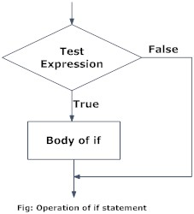
Python if Statement Flowchart

Slide 5
Example: Python if Statement
# If the number is positive, we print an appropriate message
num = 3
if num > 0:
print(num, "is a positive number.")
print("This is always printed.")
num = -1
if num > 0:
print(num, "is a positive number.")
print("This is also always printed.")

Slide 6
The output will be:
3 is a positive number
This is always printed
This is also always printed.
In the above example, num > 0 is the test expression.
The body of if is executed only if this evaluates to True.
When variable num is equal to 3, test expression is true and body inside body of if is executed.
If variable num is equal to -1, test expression is false and body inside body of if is skipped.
The print() statement falls outside of the if block (unindented). Hence, it is executed regardless of the test expression.

Slide 7
Python if...else Statement
if test expression:
Body of if
else:
Body of else
The if..else statement evaluates test expression and will execute body of if only when test condition is True.
If the condition is False, body of else is executed. Indentation is used to separate the blocks

Slide 8
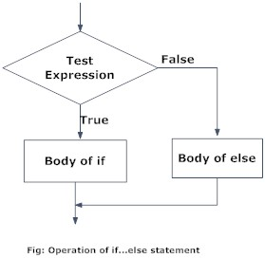
Python if…else Statement Flowchart

Slide 9
Example: Python if…else Statement
# Program checks if the number is positive or negative
# And displays an appropriate message
num = 3
# Try these two variations as well.
# num = -5
# num = 0
if num >= 0:
print("Positive or Zero")
else:
print("Negative number")

Slide 10
The output will be:
Positive or Zero
In the above example, when num is equal to 3, the test expression is true and body of if is executed and body of else is skipped.
If num is equal to -5, the test expression is false and body of else is executed and body of if is skipped.
If num is equal to 0, the test expression is true and body of if is executed and body of else is skipped.

Slide 11
Python if...elif...else Statement
if test expression:
Body of if
elif test expression:
Body of elif
else:
Body of else

Slide 12
The elif is short for else if. It allows us to check for multiple expressions.
If the condition for if is False, it checks the condition of the next elif block and so on.
If all the conditions are False, body of else is executed.
Only one block among the several if...elif...else blocks is executed according to the condition.
The if block can have only one else block. But it can have multiple elif blocks.

Slide 13
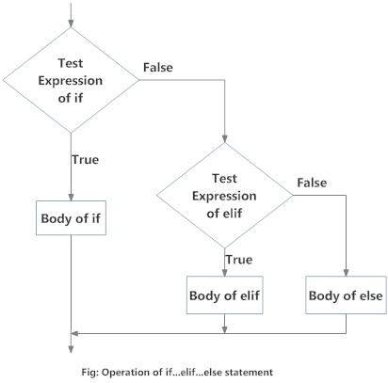
Python if...elif...else Flowchart

Slide 14
Example: if...elif...else
# In this program, we check if the number is positive or
# negative or zero and display an appropriate message
num = 3.4
# Try these two variations as well:
# num = 0
# num = -4.5
if num > 0:
print("Positive number")
elif num == 0:
print("Zero")
else:
print("Negative number")

Slide 15
The output will be:
When variable num is positive, Positive number is printed.
If num is equal to 0, Zero is printed.
If num is negative, Negative number is printed

Slide 16
Python Nested if statements
We can have a if...elif...else statement inside another if...elif...else statement. This is called nesting in computer programming.
Any number of these statements can be nested inside one another. Indentation is the only way to figure out the level of nesting. This can get confusing, so must be avoided if we can.

Slide 17
Example: Nested if
# In this program, we input a number check if the number is positive or
# negative or zero and display an appropriate message
# This time we use nested if
num = float(input("Enter a number: "))
if num >= 0:
if num == 0:
print("Zero")
else:
print("Positive number")
else:
print("Negative number")

Slide 18
Output 1
Enter a number: 5
Positive number
Output 2
Enter a number: -1
Negative number
Output 3
Enter a number: 0
Zero

Slide 19
Python for Loop
The for loop in Python is used to iterate over a sequence (list, tuple, string) or other iterable objects. Iterating over a sequence is called traversal.
for val in sequence:
Body of for
Here, val is the variable that takes the value of the item inside the sequence on each iteration.
Loop continues until we reach the last item in the sequence. The body of for loop is separated from the rest of the code using indentation.

Slide 20
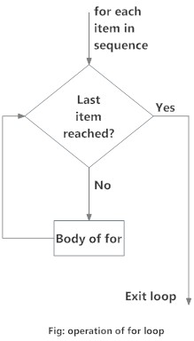
For Loop Flowchart

Slide 21
Example: Python for Loop
# Program to find the sum of all numbers stored in a list
# List of numbers
numbers = [6, 5, 3, 8, 4, 2, 5, 4, 11]
# variable to store the sum
sum = 0
# iterate over the list
for val in numbers:
sum = sum + val
# Output: The sum is 48
print("The sum is", sum)

Slide 22
The range() function
We can generate a sequence of numbers using range() function. range(10) will generate numbers from 0 to 9 (10 numbers).
We can also define the start, stop and step size as range(start, stop, step size). step size defaults to 1 if not provided.
This function does not store all the values in memory, it would be inefficient. So it remembers the start, stop, step size and generates the next number on the go.
To force this function to output all the items, we can use the function list().

Slide 23
The following example will clarify this.
# Output: range(0, 10)
print(range(10))
# Output: [0, 1, 2, 3, 4, 5, 6, 7, 8, 9]
print(list(range(10)))
# Output: [2, 3, 4, 5, 6, 7]
print(list(range(2, 8)))
# Output: [2, 5, 8, 11, 14, 17]
print(list(range(2, 20, 3)))

Slide 24
We can use the range() function in for loops to iterate through a sequence of numbers. It can be combined with the len() function to iterate though a sequence using indexing. Here is an example.
# Program to iterate through a list using indexing
genre = ['pop', 'rock', 'jazz’]
# iterate over the list using index
for i in range(len(genre)):
print("I like", genre[i])
The output will be:
I like pop
I like rock
​I like jazz

Slide 25
for loop with else
A for loop can have an optional else block as well. The else part is executed if the items in the sequence used in for loop exhausts.
break statement can be used to stop a for loop. In such case, the else part is ignored.
Hence, a for loop's else part runs if no break occurs.
Here is an example to illustrate this.
digits = [0, 1, 5]
for i in digits:
print(i)
else:
print("No items left.")

Slide 26
The output will be:
0
1
5
No items left.
Here, the for loop prints items of the list until the loop exhausts. When the for loop exhausts, it executes the block of code in the else and prints
No items left.

Slide 27
Python while Loop
The while loop in Python is used to iterate over a block of code as long as the test expression (condition) is true.
We generally use this loop when we don't know beforehand, the number of times to iterate.
while test_expression:
Body of while

Slide 28
In while loop, test expression is checked first. The body of the loop is entered only if the test_expression evaluates to True. After one iteration, the test expression is checked again. This process continues until the test_expression evaluates to False.
In Python, the body of the while loop is determined through indentation.
Body starts with indentation and the first unindented line marks the end.
Python interprets any non-zero value as True. None and 0 are interpreted as False.

Slide 29
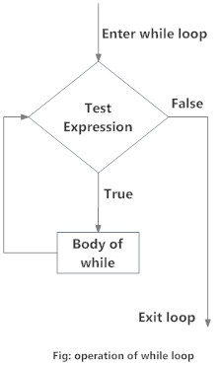
While Loop Flowchart

Slide 30
Example: while Loop
# Program to add natural numbers upto sum = 1+2+3+...+n
# To take input from the user,
# n = int(input("Enter n: "))
n = 10
# initialize sum and counter
sum = 0
i = 1
while i <= n:
sum = sum + i
i = i+1
# update counter
# print the sum
print("The sum is", sum)

Slide 31
The output will be:
Enter n: 10
The sum is 55
In the above program, the test expression will be True as long as our counter variable i is less than or equal to n (10 in our program).
We need to increase the value of counter variable in the body of the loop. This is very important (and mostly forgotten). Failing to do so will result in an infinite loop (never ending loop).
Finally the result is displayed.

Slide 32
while loop with else
Same as that of for loop, we can have an optional else block with while loop as well.
The else part is executed if the condition in the while loop evaluates to False.
The while loop can be terminated with a break statement. In such case, the else part is ignored. Hence, a while loop's else part runs if no break occurs and the condition is false.

Slide 33
Here is an example to illustrate this.
# Example to illustrate the use of else statement with the while
loopcounter = 0
while counter < 3:
print("Inside loop")
counter = counter + 1
else:
print("Inside else")
Inside loop
Inside loop
Inside loop
Inside else
Here, we use a counter variable to print the string Inside loop three times.
On the forth iteration, the condition in while becomes False. Hence, the else part is executed.

Slide 34
Python break and continue
In Python, break and continue statements can alter the flow of a normal loop.
Loops iterate over a block of code until test expression is false, but sometimes we wish to terminate the current iteration or even the whole loop without checking test expression.
The break and continue statements are used in these cases.

Slide 35
Python break statement
The break statement terminates the loop containing it. Control of the program flows to the statement immediately after the body of the loop.
If break statement is inside a nested loop (loop inside another loop), break will terminate the innermost loop.
Syntax of break
break

Slide 36
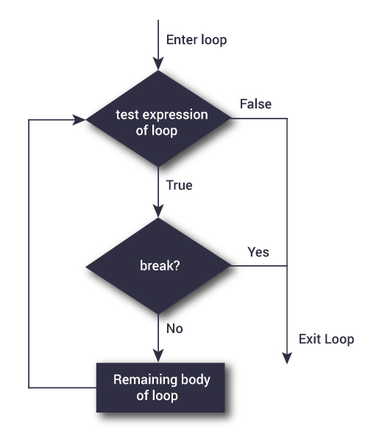
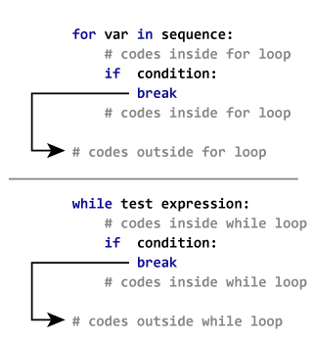
Flowchart of break
Working

Slide 37
Example: Python break
# Use of break statement inside loop
for val in "string":
if val == "i":
break
print(val)
print("The end")
Output
s
t
r
The end
In this program, we iterate through the "string" sequence. We check if the letter is "i", upon which we break from the loop. Hence, we see in our output that all the letters up till "i" gets printed. After that, the loop terminates.

Slide 38
Python continue statement
The continue statement is used to skip the rest of the code inside a loop for the current iteration only.
Loop does not terminate but continues on with the next iteration.
Syntax of Continue
continue

Slide 39
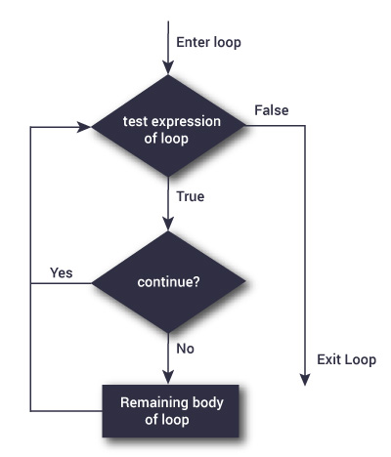
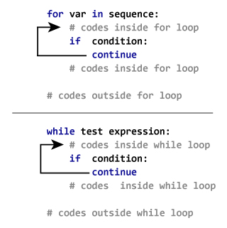
Flowchart of continue
Working

Slide 40
Example: Python continue
# Program to show the use of continue statement inside loops
for val in "string":
if val == "i":
continue
print(val)
print("The end")
Output
s
t
r
n
g
The end
This program is same as the above example except the break statement has been replaced with continue.
We continue with the loop, if the string is "i", not executing the rest of the block. Hence, we see in our output that all the letters except "i" gets printed.

Slide 41
Python pass statement
In Python programming, pass is a null statement. The difference between a comment and pass statement in Python is that, while the interpreter ignores a comment entirely, pass is not ignored.
However, nothing happens when pass is executed. It results into no operation (NOP).
Syntax of pass
pass
We generally use it as a placeholder.
Suppose we have a loop or a function that is not implemented yet, but we want to implement it in the future. They cannot have an empty body. The interpreter would complain. So, we use the pass statement to construct a body that does nothing.

Slide 42
Example: pass Statement
# pass is just a placeholder for
# functionality to be added later
sequence = {'p', 'a', 's', 's’}
for val in sequence:
pass
We can do the same thing in an empty function or class as well.
def function(args):
pass
class example:
pass

Slide 43
Python Looping Techniques
Python programming offers two kinds of loop, the for loop and the while loop.
Using these loops along with loop control statements like break and continue, we can create various forms of loop.
The infinite loop
We can create an infinite loop using while statement. If the condition of while loop is always True, we get an infinite loop.

Slide 44
Example #1: Infinite loop using while
# An example of infinite loop
# press Ctrl + c to exit from the loop
while True:
num = int(input("Enter an integer: "))
print("The double of",num,"is",2 * num)
Output
Enter an integer: 3 Enter an integer: 5
The double of 3 is 6 The double of 5 is 10
Enter an integer: 6 Enter an integer:
The double of 6 is 12 Traceback (most recent call last):

Slide 45
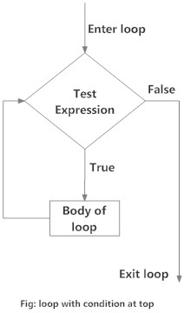
Loop with condition at the top
This is a normal while loop without break statements. The condition of the while loop is at the top and the loop terminates when this condition is False.
Flowchart of Loop With Condition at Top

Slide 46
Example #2: Loop with condition at the top
# Program to illustrate a loop with condition at the top
# Try different numbers
n = 10
# Uncomment to get user input
#n = int(input("Enter n: "))
# initialize sum and counter
sum = 0
i = 1
while i <= n:
sum = sum + i
i = i+1
# update counter and print the sum
print("The sum is",sum)
When you run the program, the output will be:
The sum is 55

Slide 47
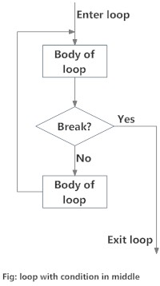
Loop with condition in the middle
This kind of loop can be implemented using an infinite loop along with a conditional break in between the body of the loop.
Flowchart of Loop with Condition in Middle

Slide 48
Example #3: Loop with condition in the middle
# Program to illustrate a loop with condition in the middle.
# Take input from the user until a vowel is entered
vowels = "aeiouAEIOU“
# infinite loop
while True:
v = input("Enter a vowel: ")
# condition in the middle
if v in vowels:
break
print("That is not a vowel. Try again!")
print("Thank you!")
Output
Enter a vowel: r
That is not a vowel. Try again!
Enter a vowel: 6
That is not a vowel. Try again!
Enter a vowel: ,
That is not a vowel. Try again!
Enter a vowel: u
Thank you!

Slide 49
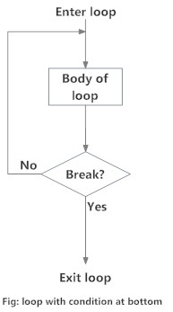
Loop with condition at the bottom
This kind of loop ensures that the body of the loop is executed at least once. It can be implemented using an infinite loop along with a conditional break at the end.
This is similar to the do...while loop in C.
Flowchart of Loop with Condition at Bottom

Slide 50
Example #4: Loop with condition at the bottom
# Python program to illustrate a loop with condition at the bottom
# Roll a dice until user chooses to exit
# import random module
import random
while True:
input("Press enter to roll the dice")
# get a number between 1 to 6
num = random.randint(1,6)
print("You got", num)
option = input("Roll again?(y/n) ")
# condition
if option == 'n’:
break
Output
Press enter to roll the dice
You got 1 Roll again?(y/n) y
Press enter to roll the dice
You got 5 Roll again?(y/n) n

